Slide 1
HDFS on Kubernetes --
Deep Dive on Security and Locality
Kimoon Kim, Pepperdata
Ilan Filonenko, Bloomberg LP
Notes:
Hi everyone. My name is Kimoon. I'm a software engineer working for Pepperdata. And I am Ilan Filonenko an incoming software engineer working for Bloomberg LP.
Pepperdata, Bloomberg and several other companies have been building a new big data stack on Kubernetes.
Together we made it possible to run Spark on Kubernetes.
Now, we are adding HDFS, Hadoop Distributed File System to the big data stack on Kubernetes.
Spark and HDFS should work closely together. And we had to fix a few issues in how they work together on Kubernetes.
So we want to talk about that today.

Slide 2
Agenda
Kubernetes intro
Big Data on Kubernetes
Demo: Spark on K8s accessing secure HDFS
Secure HDFS deep dive
HDFS running on K8s
Data locality deep dive
Demo: Namenode HA
Notes:
Here’s the outline of the talk. First, I’ll do a quick introduction on Kubernetes.
Then, Ilan is going to talk about how we are building the Big Data stack on Kubernetes.
Then Ilan is going to give a short demo of how to run Spark on Kuberentes, then deep dive into the secure HDFS support.
Then I’ll come back and talk about how we run HDFS itself on Kubernetes, do a deep dive on the HDFS data locality. I’ll finish with a short demo on the namenode HA.

Slide 3
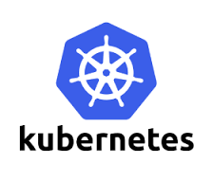
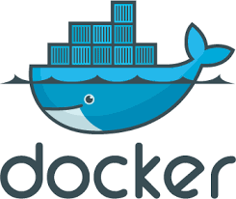
Kubernetes
New open-source cluster manager.
github.com/kubernetes/kubernetes
app
app
libs
libs
app
app
Runs programs in Linux containers.
libs
libs
kernel
1600+ contributors and 60,000+ commits.
Notes:
But first, what is Kubernetes?
Kubernetes is a new open-source cluster management software released by Google in 2014. So it manages many computers and runs many programs using those computers. In this sense, it’s similar to YARN or Mesos.
3-2. [What sets apart Kubernetes is that when it runs programs it puts them in special runtime environments] called Linux containers, which are also known as dockers or rockets.
[Containers and dockers are very popular. people wanted to run them on a cluster. Kubernetes does just that.]
[It is actually designed and built for containers, based on Google’s experience of running containers for 10 years. Ever since it was released, a lot of people joined the project and built a big community.]

Slide 4
DON’T
TOUCH
MY STUFF
“My app was running fine until someone installed their software”
Notes:
So what’s the benefit of using containers?
Many of us have this bad experience. [My Spark job suddenly failed with the ClassNotFound exception when someone installed a new version of Spark. Or I had to change my Tomcat port, because someone else was running another Tomcat on the same host. They shouldn’t touch my stuff especially when it was working fine. You would say. But what can you do? It keeps happening

Slide 5
More isolation is good
Kubernetes provides each program with:
a lightweight virtual file system -- Docker image
an independent set of S/W packages
a virtual network interface
a unique virtual IP address
an entire range of ports
Notes:
[Containers solve this problem fundamentally. They create more (isolation) layers between programs using virtualization technologies that (virtual) machines are based on.]
[But unlike virtual machines, containers are still very fast because they picked a specific set of technologies that are efficient and light weight.]
First, each program gets a virtual file system that contains an independent set of software packages. [So that this other person can install new packages only on his container without affecting my program.]
[What if I have a server program like Tomcat. Do I need to change the port depending on who else is running Tomcat?]
Kubernetes gives each program a virtual network interface that comes with a unique virtual IP address. [So both my Tomcat and your Tomcat can open the same port under different IP addresses.]

Slide 6
Other isolation layers
Separate process ID space
Max memory limit
CPU share throttling
Mountable volumes
Config files -- ConfigMaps
Credentials -- Secrets
Local storages -- EmptyDir, HostPath
Network storages -- PersistentVolumes
Notes:
There are more isolation layers around process ID space, max memory and CPU limit.
You can mount external data on containers using Kubernetes volumes. Like credentials using the Kubernetes secretes and local disk directories using the HostPath.
With these virtualization technologies, kubernetes became very popular among micro services, each of which is a simple server program that provides only one service.

Slide 7
Kubernetes architecture
Pod, a unit of scheduling and isolation.
runs a user program in a primary container
holds isolation layers like a virtual IP in an infra container
Pod 1
Pod 2
Pod 3
10.0.0.2
10.0.0.3
10.0.1.2
node A
node B
196.0.0.5
196.0.0.6
Notes:
Here’s how a Kubernetes cluster looks.
We have multiple cluster nodes, like node A and B. There can be more nodes. I’m showing only two for (illustration) purpose.
Across the cluster nodes, we run multiple programs in these things called pods.
So what is a pod?
[A pod is a unit of scheduling and isolation in Kubernetes. So a pod typically consists of these two containers. It runs a user program like Tomcat in a primary container. There is also an infrastructure container that holds isolation layers like a virtual IP address.
Here, you see pod 1, 2 and 3. Each pod may have a different docker image. Each pod has a unique virtual IP address, like 10.0.0.2. Because they are virtual, these pod IP addresses look different from physical node IP addresses like 196.0.0.5.
Cool. Now, Ilan is going to talk about Big Data on Kubernetes.

Slide 8
Big Data on Kubernetes
github.com/apache-spark-on-k8s
Bloomberg, Google, Haiwen, Hyperpilot, Intel, Palantir, Pepperdata, Red Hat, and growing
Patching up Spark Driver and Executor code to work on Kubernetes.
Upstreaming. Part of Spark 2.3 -- “Spark release 2.3.0. … Major features: Spark on Kubernetes: [SPARK-18278] A new kubernetes scheduler backend that supports native submission of spark jobs to a cluster managed by kubernetes. ...”
Related talk: spark-summit.org/2017/events/apache-spark-on-kubernetes/
Notes:
We found that at Bloomberg we wanted to run multiple big data applications on-top of Kubernetes. One of which was Apache Spark. It was exciting to see that we were not alone.
As such, both myself and Kimoon began working with various companies on building native integration for Kubernetes with Apache Spark in a separate fork before pushing it upstream. This fork houses all the features we wish to merge upstream including all the work that will be discussed in this talk
I will enumerate just some of the advantages of native integration over spark standalone
Spark executors can be elastic depending on job demands as spark can speak directly to kubernetes in order to provision executors as required
Being able to leverage Kubernetes constructs like ResourceQuota, and service accounts
Greater resource isolation and security
Allows the user to specify a custom docker image for the driver and executors when the user submits the job
We are excited to share that Kubernetes is a part of Spark 2.3. Right now we are restructuring the driver and executor logic, and our roadmap for Spark 2.4 includes:
Dynamic resource allocation + external shuffle service
Python and R support
Priorities and preemption for pods
HDFS work presented in this talk

Slide 9
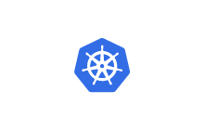
Spark on Kubernetes
Spark Core
Kubernetes Scheduler Backend
configuration
Kubernetes Cluster
new executors
remove executors
Resource Requests
Authnz
Communication with K8s
Notes:
But how does a spark job launch using resources managed by Kubernetes. To do this we modified the spark code by allow spark core to communicate with a Kubernetes Scheduler Backend.
This scheduler backend contains all the calls to communicate with a Kubernetes Cluster such as resource requests and authentication

Slide 10
Spark on Kubernetes
Job 1
Job 2
Client
Driver Pod
Executor Pod 1
Executor Pod 2
10.0.0.2
10.0.0.3
10.0.1.2
Driver Pod
Executor Pod 1
Executor Pod 2
Client
10.0.0.4
10.0.0.5
10.0.1.3
node A
node B
196.0.0.5
196.0.0.6
Notes:
But how do you launch a job in Spark on Kubernetes: you would submit a job from outside the cluster. *click* *click* The driver launches in a pod that will be configured using a submission client and the driver in turn *click* launches executors also in pods (across cluster nodes).
The Driver and Executor pods will also get unique virtual IP addresses that they will communicate with. Communication happens via the Virtual Network Interface.
If other jobs *click* run within the same Kubernetes namespace: (or virtual cluster, backed by the same physical cluster) they will not interfere with each other as they are all unique pods with possibly unique docker images

Slide 11
What about storage?
Spark on Kubernetes supports cloud storages like S3.
Your data is often stored on HDFS:
Access remote HDFS running outside Kubernetes
Run HDFS itself on Kubernetes -- github.com/apache-spark-on-k8s/kubernetes-HDFS
Driver Pod
Executor Pod 1
Executor Pod 2
10.0.0.2
10.0.0.3
10.0.1.2
Driver Pod
Executor Pod 1
Executor Pod 2
Kerberos
node A
node B
196.0.0.5
10.0.0.2
10.0.0.3
196.0.0.6
10.0.1.2
node A
Datanode 1
node B
Datanode 2
Namenode
Namenode
Datanode 1
Datanode 2
196.0.0.5
196.0.0.6
Notes:
How do we store big data that Spark needs to access. Some solutions are S3, but more commonly it is stored in HDFS
There are two options: *click* *click* HDFS running outside of the cluster. in essence a remote DMZ cluster that Spark on Kubernetes can communicate with.
As HDFS, in production clusters, is commonly secured with Kerberos. These kerberized clusters will therefore have three unique nodes. *click*
The first is a Kerberos Node which functions as an Authentication Server for users and services
Now since HDFS has a master/slave architecture, the other two types of nodes includes a NameNode, which is a master server that manages the file system namespace and regulates access to files by clients
and DataNodes, which manage storage attached to the nodes that they run on.
DataNodes have the ability to perform block creation, deletion, and replication upon instruction from the NameNode.
As you can see in the example the namenode and datanodes live outside the Kubernetes cluster. The other option is: *click* *click*
HDFS running on Kubernetes *click* itself by loading the namenode and datanodes as pods with unique labels and mounts that we will elaborate upon later in the talk.
This work can be found in the fork

Slide 12
Agenda
Kubernetes intro
Big Data on Kubernetes
Demo: Spark on K8s accessing secure HDFS
Secure HDFS deep dive
HDFS running on K8s
Data locality deep dive
Demo: Namenode HA
Notes:
I will now do a short demo elaborating on how Spark on Kubernetes interacts with Secure HDFS and then do a deep dive into the actual inner workings of Secure HDFS interaction.

Slide 13
Demo: Spark k8s Accessing Secure HDFS
Running a Spark Job on Kubernetes accessing Secure HDFS
https://github.com/ifilonenko/secure-hdfs-test
Notes:
In this demo, which can be found in the link above, we will show-case the functionality of spark-on-kubernetes and the simplicity of native integration. We will also attempt to run an example spark application that accesses secure hdfs.
We begin by showcasing the pods currently running on our kubernetes cluster. *press play** and pause at 0:01 This can be seen with the kubectl get pods command.
In the beginning we see 4 separate pods. The latter three are the data-node, namenode, and kerberos or kdc node, that we specified in the storage overview. The first node, named the data-populator node, is responsible for logging into the kerberos server to obtain valid authentication to then access the datanodes and then copy over a dummy file into hdfs. At this point in time, the data-populator node has successfully copied the data into hdfs (if there are further question, I have included in the appendix a walkthrough in setting up this cluster and a verification that the example file is securely stored on this hdfs cluster). **click play **
We will then run a command that starts a proxy to the Kubernetes API server. This allow us to access the dashboard via the following URL. This will help us monitor the kubernetes cluster for health, pod status, and storage configurations. As we can see upon initializing we do not have anything hadoop specific stored in our config maps or secrets. Later on in the presentation I will elaborate on how we populate such. I now execute a command that setups a pod configured to run an example spark-on-k8s instruction. This pod is configured to be built off of the spark-base docker image. The reason for this pod is so that we may have an isolated environment to set environmental variables and define hadoop specific configuration directories. For this demo, the pods entrypoint is a sleep command so that we may be able to ’ssh into the pod to run a spark-submit command.
We will now investigate the spark-submit command the env variables that we have included. The important thing to note is the initialization of our environment for SPARK_SUBMIT commands dealing with HDFS. The obvious one is specifying the HADOOP_CONF_DIR (like in Yarn) which is where all of your .xml Hadoop configuration files are. Now we will walk through the uniqueness of the spark-submit command. As you can see, the master configuration is uniquely named with k8s:// and our kubernetes API server endpoint. We also see the customization of the driver and executor images. We also have a unique spark. kerberos configuration that is enabled. This specific command runs kinit before, but also passes in a keytab / principal. For those of you who aren’t aware of these hadoop concepts: kinit obtains and caches credentials for login into Kerberos while keytabs and principals are used to perform user authentication (i.e. username password).
Later in the demo we will see the success of the command without the keytab and principal and just the initial kinit. We also support the ability to specify pre-populated secrets as another config so 3 methods in total: kinit,keytabs, or pre-populated secrets. The argument passed into the spark-submit is the location of the file stored on hdfs: `people.txt`. Now let’s run it *click play* Here we see the driver and executor pods lauched on the same cluster as HDFS and when looking the logs, we see the success of the application with the “Iteration” print statement. Stop @ 1:57. We will come back to this demo after taking a deep dive into what is going on

Slide 14
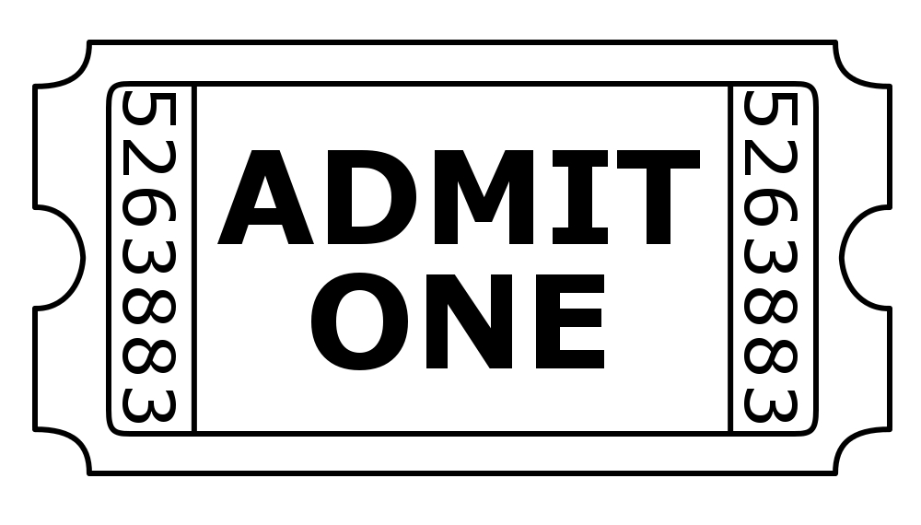
Security deep dive
Kerberos tickets
HDFS tokens
Long running jobs
Access Control of Secrets
Notes:
In this deep dive I will begin by explaining what are Kerberos tickets
*click*
HDFS delegation tokens *click*
And how we support long running jobs and access control to secrets *click*

Slide 15
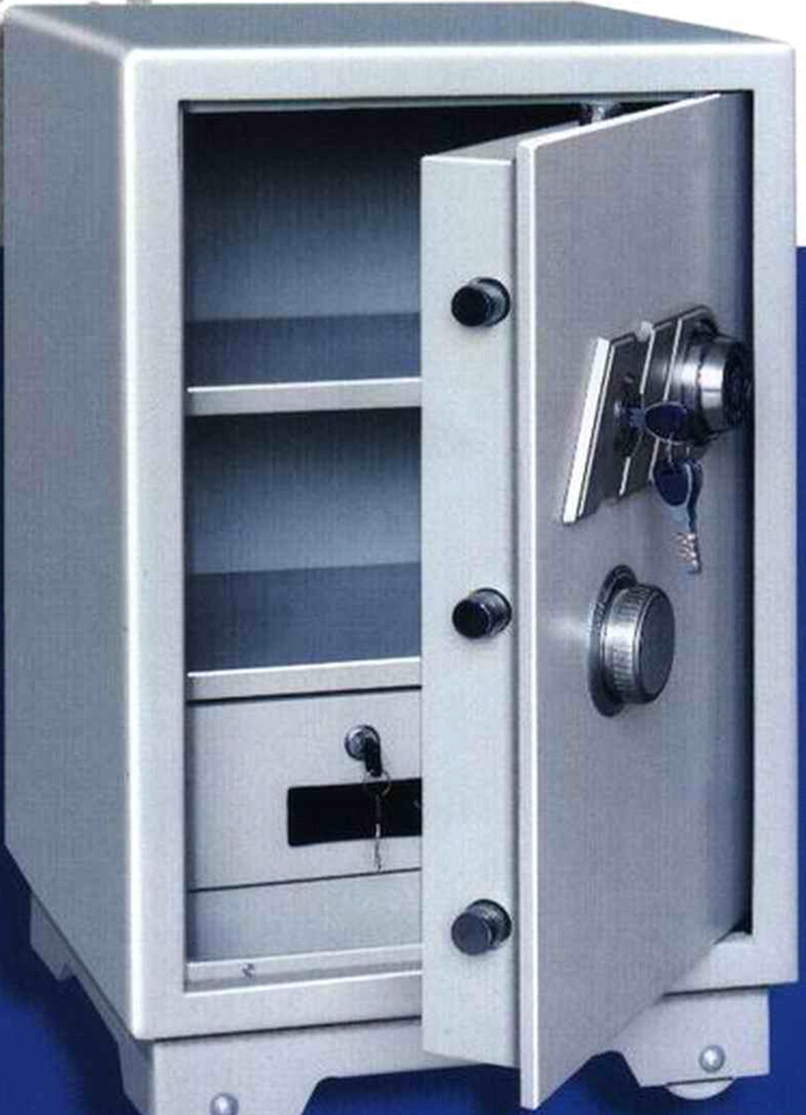
Kerberos, simplified
encrypted with HDFS’ password
encrypted with A’s password
encrypted with session key SK1
Order # SK1
Customer copy
Order # SK1
Merchant copy
I’m user A. May I talk to HDFS?
SK1
Kerberos Server
You guys should talk only if the other side knows SK1.
I’ll get SK1 to each of you secretly.
I guarantee that the other side is genuine if they know SK1.
SK1 copy for User A
SK1 copy for HDFS
A’s password
HDFS’ password
User A
Ticket to HDFS
SK1 copy for HDFS
SK1
SK1
HDFS namenode
Session 1 Requests/Responses
HDFS’ password
Notes:
But first, how does Kerberos actually work. The goal in secure HDFS interaction is that User A wishes to communicate with the Namenode to (for example) access a data-block located on a DataNode. The NameNode is configured and can only be accessed with a unique password called HDFS password.
If we are to generalize Kerberos it should be known that every service needs to have its own account, and there must be a password attached for verification to ensure that users don’t send sensitive data to malicious services that are unauthorized. All users and services are registered in the Kerberos Server. In this case it would be User A and Service HDFS.
*click*
User A will communicate with the server to obtain a Session Key (SK1) *click* that will be used to encrypt conversation with the HDFS NameNode. *click* To ensure that HDFS isn’t malicious and User A is who he says he is, Kerberos Server’s goal is to give SK1 to the server and the user secretly. That is the goal of this interaction.
*click* *click*
The response message will be a nested message with two copies of the SK1 for both the User and the HDFS NameNode Service each of which is encrypted with the proper password (either HDFS or User A).
*click*
This is like having two copies of a receipt. The merchant copy for HDFS and the customer copy for User A. The analogy continues by imagining two nested safes. *click* Where we put the merchant copy (for HDFS) into the smaller safe which we would lock with HDFSs password *click*. And then putting the customer copy for (User A) into the larger safe and locking that with User As password. *click* And sending the entire safe to User A.
User A will then unlock the outer safe with his password *click* to obtain its copy of SK1 and send the remaining *click* inner safe for HDFS Namenode to unlock with ITS unique password to obtain its *click* copy of SK1. This message also includes information about User A so the Service is aware of the User sending the message.
The function of this is so that the User and HDFS may communicate with each other over an encrypted channel *click* using a known Session Key. *click*
Having the SK1 that is encrypted with HDFS is called a HDFS Service Ticket *click*, showing permission for a User to use the HDFS Service by the Kerberos Server.

Slide 16
HDFS Delegation Token
Kerberos ticket, no good for executors on cluster nodes.
Stamped with the client IP.
Give tokens to driver and executors instead.
Issued by namenode only if the client has a valid Kerberos ticket.
No client IP stamped.
Permit for driver and executors to use HDFS on your behalf across all cluster nodes.
Notes:
Tickets are good, but aren’t sufficient for big data applications, because there was a security loophole where tickets can be reused. As such, Kerberos Tickets were stamped with the client IP address to eliminate the possibility of reusability. *click*
This won’t work in a Spark Application where there are multiple executors on different cluster nodes.
As such, HDFS leverages Delegation Tokens *click* which are provided by the Namenode only if the client has a valid ticket. But these tokens have no client IPs.
This allows drivers and executors to use these tokens for communication with the HDFS.

Slide 17
Solved: Share tokens via K8s Secret
Problem: Driver & executors need token
Client
Driver Pod
Executor Pod 1
Executor Pod 2
ADMIT USER
10.0.0.2
10.0.0.3
10.0.1.2
Secret 1
node A
node B
196.0.0.5
196.0.0.6
Kerberos
Namenode
Datanode 1
Datanode 2
Notes:
However, this token needs to be sent to the driver and executor somehow, and this was the feature that was missing from Spark on Kubernetes. Spark on Yarn has an implementation by sending the token to a Resource Manager demon that would handle the rest by placing the token directly into the working directory of the driver and executor.
We wish to mimic this type of service however we don’t have YARN primitives. *click*
As such, *click* we leverage Kubernetes Secrets to communicate the token to all the driver and executor pods.
Remember when we talked about namespaces, well these secrets are shared across namespaces where all the drivers and executors would have access. Secrets are primitives exclusively used for securely mounting sensitive data using TLS that could be accessed by privileged pods that wish to mount that volume onto itself.
As such we modified the Spark Client, to allow for the client to put the token obtained into the secret.
First a User will input his password using KINIT (in essence obtaining a Ticket Granting Ticket or TGT) that he will communicate to Kerberos to obtain a HDFS Service Ticket.
*click* This ticket the Client will then send to the Namenode to obtain a HDFS Delegation Token *click*
that it will then use to mount as a secret,*click* for the drivers and executors *click* to use. *click*

Slide 18
Solved: Refresh tokens with K8s microservice
Problem: Tokens expire
Client
Driver Pod
Executor Pod 1
Executor Pod 2
10.0.0.2
10.0.0.3
10.0.1.2
Refresh Pod
Secret 1
node A
ADMIT SERVER
node B
196.0.0.5
10.0.0.8
196.0.0.6
Kerberos
Namenode
Datanode 1
Datanode 2
Notes:
However a delegation token expires *click* after 24 hours. And a service ticket expires after 7 days. As such, we needed to ensure that there was a service available that would replace and update the token such that long running jobs both above 24 hours, and some above 7 days, would run without having to stop because of unprivleged access to the NameNode.
*click* In YARN this is done by the Resource Manager demon, *click*
so instead we leverage the flexibility of Kubernetes in managing microservers to run a Microservice responsible for updating this token. *click*
However this unique and separate pod will obtain its OWN HDFS Service ticket from Kerberos *click* with its own unique Kerberos system account that will have different privileges then other job user accounts.
The uniqueness of this account is that as a generic refresh pod across a namespace, there might be other jobs running on the same namespace, so this refresh pod will need to service multiple jobs. However, even tho the Refresh pod uses its own principle to obtain a HDFS service ticket it will get a delegation token *click* bounded to the JOB user’s principle to ensure that the job user only has access to job user data.
This is an especially important note as to ensure privilege across jobs in a single namespace. As such the namenode should be configured to ensure that the refresh pod functions as a proxy for other pods. *click*
As a proxy, it updates the job user’s delegation token on behalf of the job user. *click*
After retrieving a new Delegation token it updates *click* *click* the secret with the new delegation token. *click* Updates to Secrets are automatically detected by pods which simplifies the awareness that drivers and executors need to have.

Slide 19
Solved: Keep Secret to yourself with K8s RBAC
Problem: Secrets can be exposed to others
Job 1
Job 2
Client
Driver Pod
Executor Pod 1
Executor Pod 2
10.0.0.2
10.0.0.3
Secret 1
10.0.1.2
Secret 1
Driver Pod
Executor Pod 1
Executor Pod 2
Client
10.0.0.4
10.0.0.5
10.0.1.3
node A
node B
196.0.0.5
196.0.0.6
Notes:
However what happens when multiple jobs run on a single namespace.
How do they ensure that one job user *click* isn’t able to communicate with another job users data.
*click* *click*
This problem is solved with Access Control primitives available in Kubernetes *click* but becomes tricky once you look at all the options that exist in various organization structures with unique SLAs.

Slide 20
Access Control of Secrets
HDFS DTs and renewal service keytab in Secrets
Admin can restrict access by:
 | Job owner human user | Job owner’s pods | Other human users | Other users’ pods | Renew service pods
Access to the DT secret | create | get | none | none | get, update
Access to the renewal keytab secret | none | none | none | none | get
1. Per-user AC, manual
2. Per-group AC, manual
3. Per-user AC (automated, upcoming)
Notes:
As such, *click* we need to restrict access to the HDFS delegation tokens and the renewal service keytab stored in Secrets *click*
The job owner’s HDFS DT should not be exposed to other users or their jobs.
Otherwise, they could steal or destroy the job owner’s HDFS data. The renewal service pod helping long running jobs is an exception in that it should be able to read or replace the DTs.The renewal service’s keytab file should be accessible only to the system admin user or the renewal service pod. I.e. It should not be exposed to any job users or their jobs. Otherwise, they could use the keytab file to steal or destroy HDFS data of many users.
Can Kubernetes authorization mechanisms meet this strict requirements? It depends on which authorization mechanism is used, an example is Role Based Access Control or RBAC. *click*
Kubernetes RBAC uses Roles and Rules to represent privileges for accessing Kubernetes resources
*click*
But with the uniqueness of every companies org structure and the SLAs that come with their unique business they might need to restrict access in unique ways.
With namespace being the smallest unit of granularity, we propose that
Admins restrict access by:
1. Per-user AC (manual) -- in which we have a user per namespace. This might not work in certain situations as the admin might not want a proxy user in the namenode config for every user in the org
2. Per-group AC (manual) -- in which we have a namespace dedicated to a group of users where all users could share or have their own service account, and all users within the group have access to the all the secure data
3. Per sub-group AC (automated, not yet implemented) -- in which we have a namespace with sub-groups that have different privilege levels. This can be solved by applying owner labels to secrets dynamically (this still needs to be developed within Kubernetes RBAC) and is currently not supported. The other option would be to use the authorization plugin to give specific user access to pre-populated secrets or pre-created secrets. These pre-populated secrets could be defined in the spark-submit command as well.

Slide 21
Demo: Spark k8s Accessing Secure HDFS
Running a Spark Job on Kubernetes accessing Secure HDFS
https://github.com/ifilonenko/secure-hdfs-test
Notes:
Going back to the demo @1:38
We see that the submission client mounted Hadoop specific files via config maps onto the driver. And also mounted the DT as a secret in the logs.
This can be seen @1:59 with all the necessary files to secure a connection available to the driver. And the delegation token present for proper login into the namenode.
Also take note at the refresh-hadoop-tokens label that the renewal pod will use to check to update.
As you can see the application cleanly succeeded.
However, what happens when we modify the query to not include the keytab / principal and just used the cached TGT that we achieved via kinit.
Here we check the cache by running klist. And now we see that the command is running and clearly succeed. What is to happen when we remove the TGT from the cache by running kdestroy.
We see it throw a sensible error saying that the Hadoop login was unable to find a kerberos tgt.

Slide 22
Agenda
Kubernetes intro
Big Data on Kubernetes
Demo: Spark on K8s accessing secure HDFS
Secure HDFS deep dive
HDFS running on K8s
Data locality deep dive
Demo: Namenode HA
Driver Pod
Executor Pod 1
Executor Pod 2
node A
node B
196.0.0.5
10.0.0.2
10.0.0.3
196.0.0.6
10.0.1.2
node A
Datanode 1
node B
Datanode 2
Namenode
Namenode
Datanode 1
196.0.0.5
196.0.0.6
Notes:
Cool. Thanks Ilan. That was secure HDFS support.
Now, let’s talk about how we made HDFS itself run on Kubernetes.
This HDFS on Kubernetes will be useful long term if you want to move your data to Kubernetes as well and consolidate your infrastructure.

Slide 23
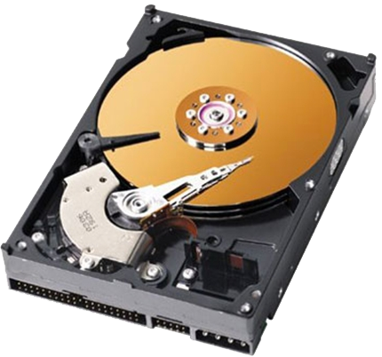
Run HDFS itself on Kubernetes
Spark
github.com/apache-spark-on-k8s/kubernetes-HDFS
HDFS
Zookeeper
Journal node
Client
Driver Pod
Executor Pod 1
Executor Pod 2
10.0.0.2
10.0.0.3
10.0.1.2
active
StatefulSet
standby
anti pod affinity
Namenode Pod 1
Namenode Pod 2
ZK Pod 1
JN Pod 1
Persistent volume 1
ZK Pod 2
JN Pod 2
Persistent
volume 2
ZK Pod 3
JN Pod 3
Datanode Pod 1
Datanode Pod 2
Datanode Pod 3
Kerberos
DaemonSet
HostPath
HostPath
HostPath
node A
node B
node C
196.0.0.5
196.0.0.6
196.0.0.7
Notes:
So how do we run HDFS? We leverage Kubernetes support for micro services and run HDFS as a collection of micro services.
HDFS has two types of daemon programs. The name node daemon maintains the file system metadata. And we support the name node HA, High Availability.
So we run two name node pods with each pod mounting a network persistent volume for storing a copy of meta data.
This HA setup is done using a Kubernetes construct, StatefulSet of size 2, which is a way to make sure the two pods are up and running all the time.
So if somebody accidentally turns off the power on node A, Kubernetes will automatically start a replacement name node pod on a different cluster node, say node C and remount the persistent volume 1 on the new pod.
And we made sure to spread the two pods across different cluster nodes using a Kubernetes API, anti pod affinity, saying I don’t want my pods to go near each other, especially not to the same cluster node.
So we have two name nodes. But only one name node should be active at a given time point. To determine who’s active and who’s standby, they talk to zookeeper servers, which are in their own HA setup using a another StatefulSet of size 3.
And I didn’t show it here. But they use their own persistent volumes.
And the active name node should modify the metadata as clients make requests for adding or deleting files. The metadata update should be shared with the standby name node so that it can take over when the active name node crashes. For that, they talk to this helper service, journal nodes in a StatefulSet of size 3.
The second HDFS daemon type is data nodes that store the actual file data.
We run one data node pod on each and every cluster node, which is a rule enforced automatically by another Kubernetes construct DaemonSet. And this rule applies even in the future. So if cluster admin adds 10 more cluster nodes tomorrow, each of them will start one data node pod.
Data node pods store the file data on the local disks of cluster nodes using Kuberenetes HostPath volumes.
And we support Kerberos configuration for securing data as an option. So the secure HDFS support that Ilan talked about applies here as well.
Finally, [the name node and data node daemon pods are special pods. Daemons don’t actually need virtual IP addresses because there is only one instance of each type on a given node. There is no need to worry about port collision. So we chose not to get virtual network interfaces for these pods, which is possible. So these daemons are associated with physical IP addresses of cluster nodes like 196.0.0.5.
This becomes important when we talk about the data locality]

Slide 24
Locality deep dive
Send compute to data
Node locality
Rack locality
Where to launch executors
Spark on K8s had to be fixed
Executor 1
Executor 2
FAST
SLOW
Datanode 1
Datanode 2
node A
node B
Notes:
So what is data locality? The main idea is to send compute to where data is.
Your Spark job has many different tasks. Each task wants to process a particular slice of data called a partition. Then you send those tasks to where those partitions are. Because reading data over the network can be slow if your network is slow. Reading the partition data straight from the local disks will be much faster.
Spark driver has source code that interacts with the data locality. But this data locality layer was initially broken in Spark on Kubernetes. It was broken at many levels. Let’s take a look.

Slide 25
Problem: Node locality broken with virtual pod IPs
Solved: Node locality
(/fileA → Datanode 1 → 196.0.0.5) == Location of Executor 1
(/fileA → Datanode 1 → 196.0.0.5) != (Executor 1 →10.0.0.3)
(/fileA → Datanode 1 → 196.0.0.5) == (Executor 1 →10.0.0.3 → 196.0.0.5)
Location of fileA == Location of Executor 1
Read /fileB
Driver
Read /fileA
Executor Pod 1
Executor Pod 2
10.0.0.2
10.0.0.3
10.0.1.2
/fileA
/fileB
Namenode Pod
Datanode Pod 1
Datanode Pod 2
node A
node B
196.0.0.5
196.0.0.6
Notes:
When a particular node has the partition of a task, we want to send the task to the exact node. This is node level data locality.
This Spark job wants to read file A an file B on HDFS. File A is on node A and file B on node B. So we want the Spark driver to be smart enough to send the task for reading file A to executor 1 on node A, where file A is. And send another task for reading file B to executor 2 on node B. Tasks will go there and read data from local disks with the help of local data node daemons.
[How will the Spark driver as software figure this out?] The driver has source code that checks if file locations match executor locations.
Here, we compare file A location and executor 1 location. They are supposed to match. For the file A location, the driver will ask the namnode which data node is in charge of file A. The name node will say that’s data node 1. And the associated IP address is that of node A.
Then, the driver will find the IP address of the host that the executor 1 is running on. But here’s the problem. We get an unexpected IP address.
If this were YARN or Mesos, the IP address would be the same the same physical IP address of node A. But in kubernetes, executors are running in pods with unique virtual IP addresses. So the driver will find those virtual pod IP addresses. They will not match data node IP addresses.
So Spark driver would not know what to do, and send tasks to wrong executors, which will slow down tasks and jobs a lot.
So we had to fix this code. The fix itself is simple. Don’t stop after getting the executor pod IP. Also ask Kubernetes API server to find the cluster node that the executor pod is running on. Kubernetes will say that’s node A and we get the same IP address.
This is how we fixed the node locality.

Slide 26
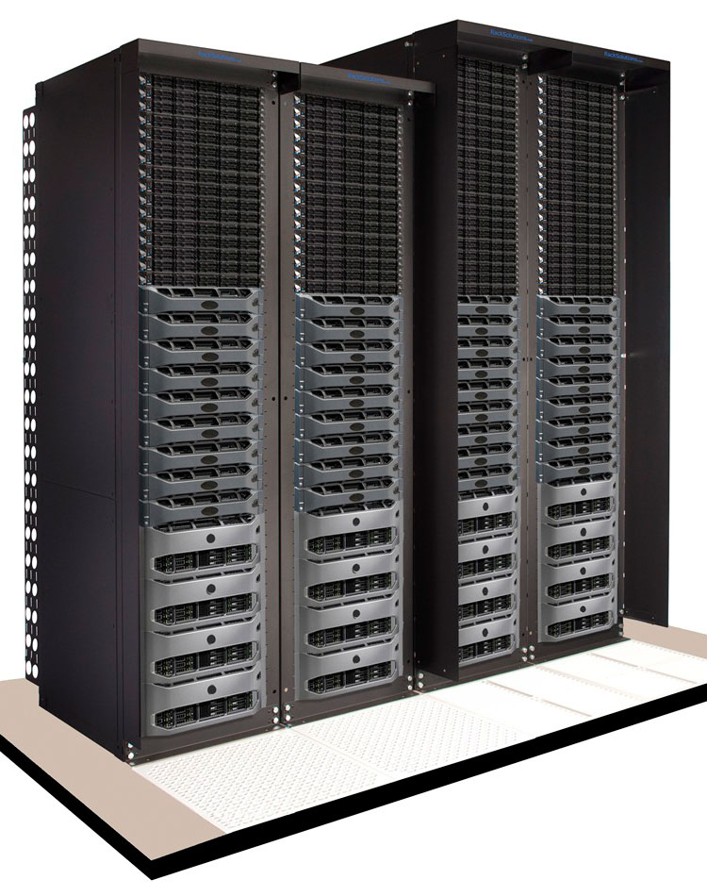
Problem: Rack locality broken with virtual pod IPs
Solved: Rack locality
(/fileA → Datanode 1 → 196.0.0.5 → Rack 1) != (Executor 1 →10.0.1.2)
(/fileA → Datanode 1 → 196.0.0.5 → Rack 1) == (Executor 1 →10.0.1.2 → 196.0.0.6 → Rack 1)
Rack of fileA == Rack of Executor 1
Read /fileB
Driver
Read /fileA
Executor Pod 1
Executor Pod 2
10.0.0.2
10.0.1.2
10.0.2.2
SLOW
/fileA
/fileB
Datanode Pod 1
Datanode Pod 2
Datanode Pod 3
node A
node B
node C
196.0.0.5
196.0.0.6
196.0.1.5
Rack 1
Rack 2
Notes:
Sometimes node locality is not available but rack locality is.
When you build a data center, you put tens of servers in a single rack. Then you put a network switch at the top of the rack that connects all servers in the rack. So servers in the same rack can talk to each other pretty fast. Not as fast as node locality but decent speed. Talking to servers in other racks can be much slower and you want to avoid that.
Here we have rack 1 and rack 2. node A and node B are in rack 1. Node C is in rack 2.
We have file A on node A and file B on node C.
Unfortunately, we don’t have any executor on node A. Maybe node A did not have enough memory. So we can't get node locality for file A.
So the next best thing is to send the task for file A to the nearby executor 1 on node B in the same rack, so it can read the data at least from the same rack. And send the task for file B to executor 2 on node C to get the node locality.
You don't want to send the file A task to executor 2 in rack 2 because reading across the rack boundary can be very slow.
The driver has another source code that compare rack locations of files with rack locations of executors. This was also broken in a similar way.
Here we compare file A rack location with executor 1 rack location. For file A, you would get node location first 196.0.0.5 like before and map that to the rack ID. So there is a rack ID mapping information that’s keyed by cluster node IP addresses.
And on the executor side, this was also broken in a similar way. The driver is stuck with the pod IP. This will not find any rack ID. The fix is pretty much the same. translate pod IP to the cluster node IP by asking Kubernetes API server, then find the rack ID.

Slide 27
Solved: Node preference
Hey K8s, I’d like node A much more for my executors
Node affinity
Driver
Executor Pod 1
Executor Pod 2
10.0.0.2
10.0.0.3
10.0.0.4
/fileA
Datanode Pod 1
/fileB
Datanode Pod 2
node A
node B
196.0.0.5
196.0.0.6
Notes:
In some cases, your data set is small compared with the cluster size and your partitions exist only on a subset of cluster nodes. In that case, you want to launch your executors on those nodes so that you can maximize the data locality benefit.
Here, as an extreme example, both file A and file B are on the node A. So, you would want both executors to launch on node A if possible. But the driver in Kubernetes did not have the source code to express this preference to the Kubernets API server.
Kubernetes has the node affinity API. So we just added the code using the API. With that, the driver will say I'd like node A more for my executors and we'll get them on node A.
This is a soft requirement. If node A doesn’t have any room, then Kubernetes scheduler will launch executors on other nodes.
But this way we increase the chance of getting data locality.

Slide 28
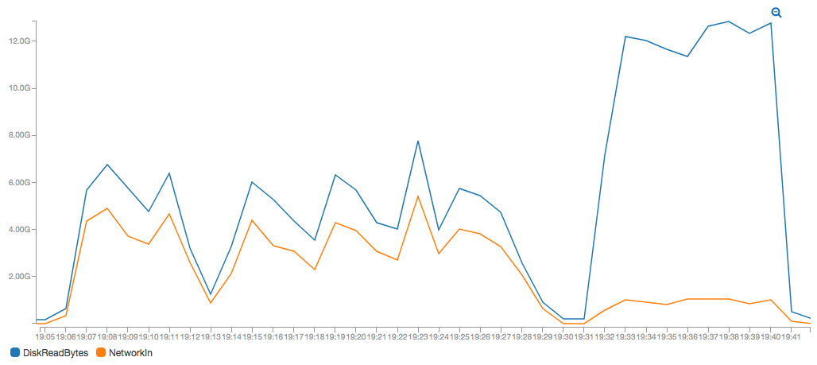
Rescued data locality!
without data locality fix
duration: 25 minutes
with data locality fix
duration: 10 minutes
Notes:
So we fixed the data locality. Does it make a difference? Let’s take a look at an experiment.
[Here, we (ran) the same Spark job twice], first without the data locality fix. And the second time with data locality fix]
The job was TeraValidate, which reads the output of TeraSort on HDFS and checks if data items are actually sorted. Both runs used the same data of size 500 GB.
Looking at the durations, it’s clear the second run finished much earlier. 10 minutes vs 25 minutes. It got faster because it increased the local disk reads a lot, the blue line, while avoiding the slow network reads, the orange line. This is thanks to the data locality. So it made a difference.

Slide 29
Demo - Namenode HA Source code in github.com/apache-spark-on-k8s/kubernetes-HDFS/pull/33
Launch HDFS pods (8x fast-forward)
Copy data while killing a namenode (normal-speed, slow-motion)
Notes:
Finally, here’s a demo of how the name node HA works.
First, I’ll show you how we launched HDFS pods in fast-forward mode.
Ok, the second part of the demo. We copy some files around while killing the active name node for fun.

Slide 30
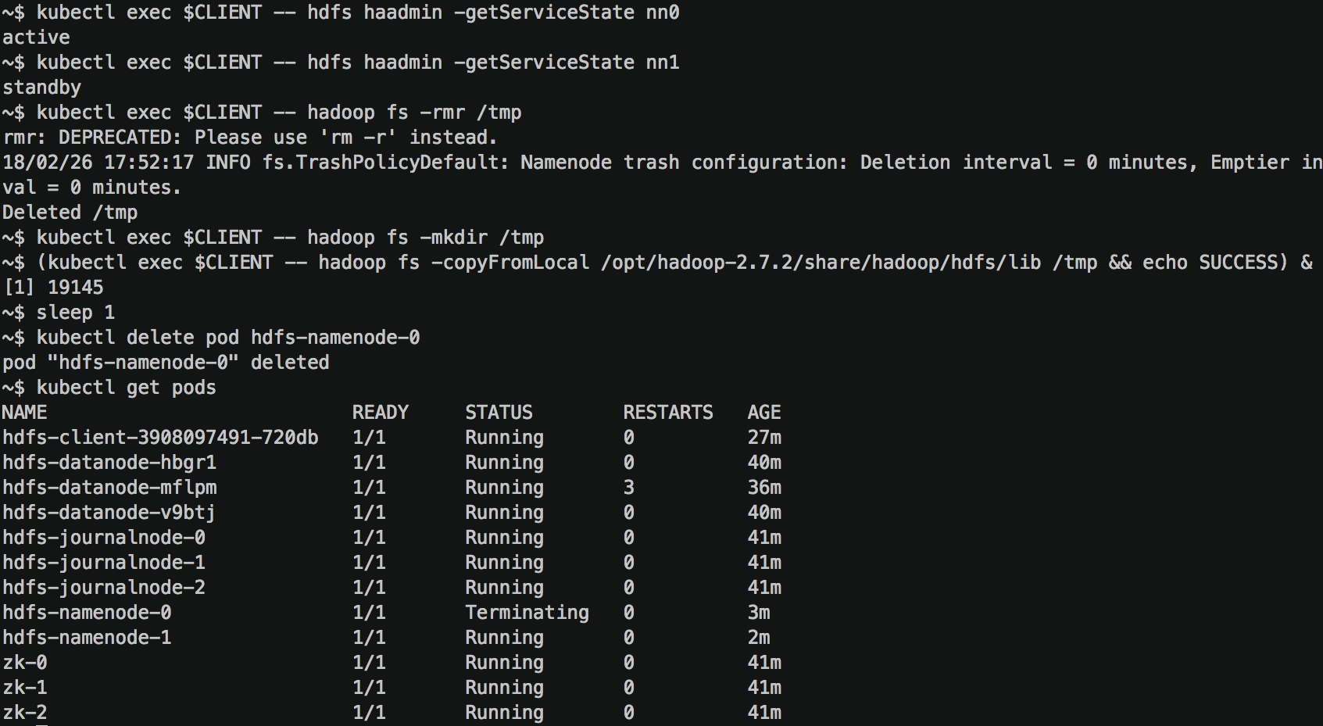

Slide 31
Join us!
github.com/apache-spark-on-k8s
www.TechAtBloomberg.com
Kimoon Kim, Pepperdata
Ilan Filonenko, Bloomberg LP

Slide 32
Appendix

Slide 33
Hadoop Cluster Setup
Launching: single-noded, pseudo-distributed, kerberized HC
https://github.com/ifilonenko/hadoop-kerberos-helm

Slide 34
Access Control of Secrets
HDFS DTs and renewal service keytab in Secrets
Admin can restrict access by:
Creating a Namespace per user
Creating a Namespace per user-group
Creating a Namespace per user-group w/ pre-populated secrets per user
Creating a Namespace per user-group w/ authorization plugin
Creating a Namespace per user-group w/ a controller pod that creates label-based ACLs

